Slide 1



Paper ID 01
Neuro-Fuzzy IDS with MRMR Feature Selection and Adaptive Ensemble Correction
Paper Id : 776
Authors Names
Kunda Suresh Babu, Pekala Veera Dhanush Kumar, Seggem Srinivas, Sk. Mynampati Saida Vali, Thannaru Venkata Siva, Yerrarapu Sravani Devi, Dodda Venkata Reddy
Name of the Department : CSE
Narasaraopeta Engineering College, Palnadu, Andhra Pradesh
2025 IEEE International Conference on Recent Advances in Computing and Systems, 19 -20 Dec 2025 | ABV-IIITM Gwalior India

Slide 2
Presentation
Outline
Introduction/ Background
Problem Statement, Dataset Description
Objectives
Methodology/ Architectures
Performance Measures
Results and Analysis
Conclusion and Future Scope
References
2025 IEEE International Conference on Recent Advances in Computing and Systems, 19 -20 Dec 2025 | ABV-IIITM Gwalior India

Slide 3
INTRODUCTION
Intrusion Detection Systems (IDS) are a core component of modern network security, responsible for monitoring traffic and identifying malicious activities in real time.
The rapid growth of cloud computing, IoT devices, and distributed systems has led to high-volume, high-dimensional, and heterogeneous network traffic, making intrusion detection more complex.
Traditional IDS approaches struggle due to noisy data, redundant features, and class imbalance, often resulting in false alarms or missed attacks.
Machine Learning and Deep Learning based IDS models have improved detection accuracy, but they suffer from:
Fixed decision thresholds that fail on uncertain predictions
Poor recall for minority and stealth attacks
High computational cost and limited interpretability
Most existing IDS solutions operate as black-box models, which reduces trust and limits their use in real-world security operations.
Handling uncertain or boundary predictions remains a major open challenge in IDS research.
This work addresses these issues by proposing “FuzzTabIDS”, a hybrid intrusion detection framework that integrates feature selection, interpretable deep learning, fuzzy logic, and ensemble-based correction.
776
2025 IEEE International Conference on Recent Advances in Computing and Systems, 19 -20 Dec 2025 | ABV-IIITM Gwalior India

Slide 4
Problem statement
Dataset Description
Modern IDS must analyze high-speed, high-dimensional network traffic, often containing more than 80 features per flow.
Many features are redundant, irrelevant, or highly correlated, leading to:
Increased training time
Overfitting
Reduced interpretability
Deep learning models output probabilistic predictions, but:
Predictions near decision boundaries (e.g., 0.49–0.51) are ambiguous
Fixed thresholds (e.g., 0.5) cause false alarms and missed detections
IDS models perform poorly on minority and stealth attack classes due to severe class imbalance.
Reliance on a single model architecture limits generalization across different attack types.
Most IDS models lack explainability and post-prediction refinement, reducing trust and operational usability.
Dataset used: CICIDS-2017
Developed by: Canadian Institute for Cybersecurity (CIC)
Total records: 2,827,876 network flow samples
Data collection period: July 3–7, 2017 (9 AM – 5 PM)
Supports:
Binary classification (Benign vs Attack)
Multi-class classification (15 attack types)
Each record contains over 80 features, including:
Flow identifiers
Time-based metrics
Statistical attributes
Behavioral features
Highly imbalanced dataset:
Benign traffic: 2,271,320 samples
Attack traffic: 556,556 samples
Contains both common and rare attacks such as:
DoS, DDoS, PortScan
Infiltration, SQL Injection, Heartbleed
776
2025 IEEE International Conference on Recent Advances in Computing and Systems, 19 -20 Dec 2025 | ABV-IIITM Gwalior India

Slide 5
OBJECTIVES
To apply Minimum Redundancy Maximum Relevance (MRMR) feature selection to identify the most relevant features while reducing dimensionality without sacrificing detection performance.
To train a TabNet-based deep learning model on the selected features, leveraging its strength on structured data and its inherent interpretability.
To incorporate a fuzzy logic-based decision layer that dynamically adjusts decision thresholds based on prediction confidence to reduce errors caused by hard thresholding.
To introduce micro-correction modules, including Decision Trees, Random Forests, and XGBoost, to re-evaluate uncertain predictions and correct edge-case misclassifications.
To design a stacked ensemble framework using weighted voting and logistic regression to improve overall detection accuracy and robustness across binary and multi-class intrusion detection tasks.
776
2025 IEEE International Conference on Recent Advances in Computing and Systems, 19 -20 Dec 2025 | ABV-IIITM Gwalior India

Slide 6
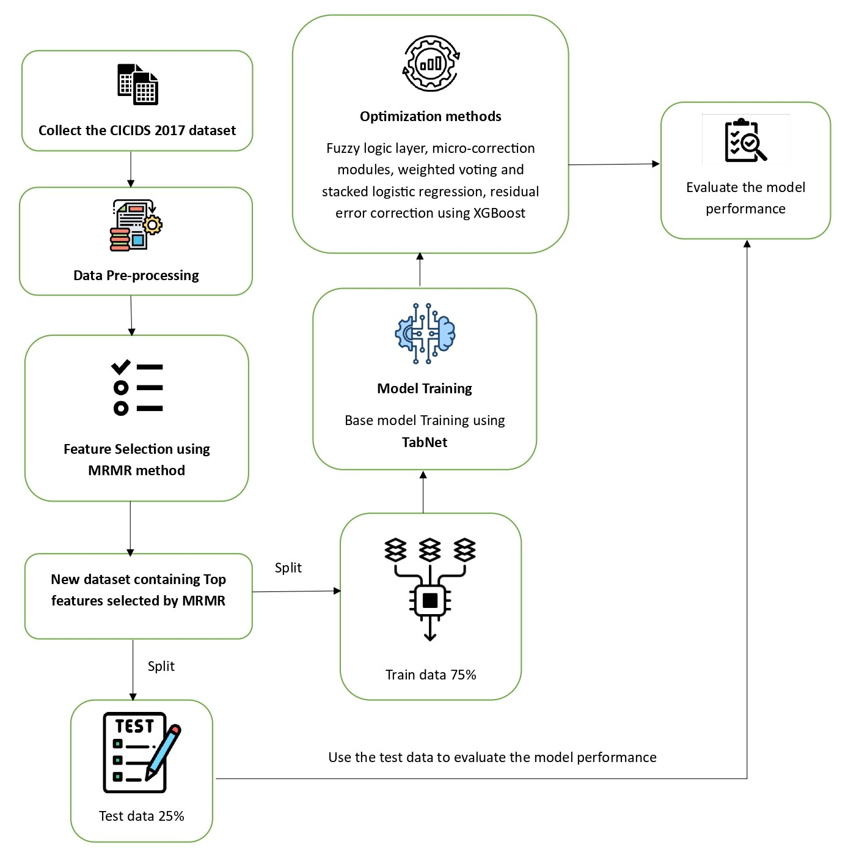
METHODOLOGY
Overall Pipeline (FuzzTabIDS)
Data preprocessing
Feature selection using MRMR
Test – Train split
Baseline classification using TabNet
Fuzzy logic–based threshold adjustment
Micro-correction using Decision Tree and Random Forest
Ensemble learning (weighted voting + stacking)
Final residual correction using XGBoost
Evaluation
Fig: Architecture Diagram
776
2025 IEEE International Conference on Recent Advances in Computing and Systems, 19 -20 Dec 2025 | ABV-IIITM Gwalior India

Slide 7
METHODOLOGY
The proposed intrusion detection framework, FuzzTabIDS, follows a multi-stage hybrid methodology designed to address high dimensionality, uncertainty in predictions, class imbalance, and lack of interpretability. The pipeline begins with a comprehensive data preprocessing stage applied to the CICIDS-2017 dataset. Non-informative and leakage-prone attributes such as flow identifiers, IP addresses, ports, and timestamps are removed. Constant features and missing values are handled through elimination and median imputation, and numerical features are normalized using Min–Max scaling. The dataset is prepared to support binary, 7-class, and 15-class classification tasks.
To reduce dimensionality and eliminate redundant information, Minimum Redundancy Maximum Relevance (MRMR) feature selection is applied. MRMR selects features that are highly relevant to the target class while minimizing redundancy among selected features using mutual information. Based on empirical evaluation, the top 30 features are selected, providing an optimal balance between performance and efficiency.
The baseline classifier in the pipeline is TabNet, a deep learning model specifically designed for tabular data. TabNet employs sequential attention mechanisms and sparse feature masking, allowing it to learn both local and global feature relationships while maintaining interpretability. Along with predictions, TabNet outputs confidence scores that are used for uncertainty handling.
776
2025 IEEE International Conference on Recent Advances in Computing and Systems, 19 -20 Dec 2025 | ABV-IIITM Gwalior India

Slide 8
METHODOLOGY
To manage ambiguous predictions, a fuzzy logic-based decision layer is introduced. Instead of using a fixed threshold, adaptive lower and upper thresholds are defined around the decision boundary. Predictions falling within this fuzzy zone are treated as uncertain and passed to correction modules. These modules include a shallow Decision Tree and a Random Forest trained specifically on fuzzy-zone errors, enabling efficient correction of hard-to-classify and minority attack samples without retraining the entire model.
Further robustness is achieved through ensemble learning. Predictions from TabNet, LightGBM, and Random Forest are combined using weighted voting and stacking with Logistic Regression as a meta-classifier. Finally, an XGBoost model is trained on the remaining misclassified samples after the ensemble stage to correct residual errors. The entire pipeline is evaluated using stratified train-test splits, cross-validation, and temporal validation to ensure generalization and avoid data leakage.
776
2025 IEEE International Conference on Recent Advances in Computing and Systems, 19 -20 Dec 2025 | ABV-IIITM Gwalior India

Slide 9
PERFORMANCE MEASURES
The performance of FuzzTabIDS is evaluated using standard classification metrics:
Accuracy
Precision
Recall
F1-Score
Evaluation is carried out for:
Binary classification (Benign vs Attack)
7-class grouped classification
15-class (all-class) classification
Metrics are computed at each stage of the pipeline to analyze the incremental contribution of:
TabNet baseline
Fuzzy logic layer
Micro-correction modules
Ensemble learning
Final XGBoost correction
Weighted and macro-averaged metrics are used where appropriate to account for class imbalance.
Validation includes:
Stratified train–test split
5-fold stratified cross-validation
Temporal split evaluation
776
2025 IEEE International Conference on Recent Advances in Computing and Systems, 19 -20 Dec 2025 | ABV-IIITM Gwalior India

Slide 10
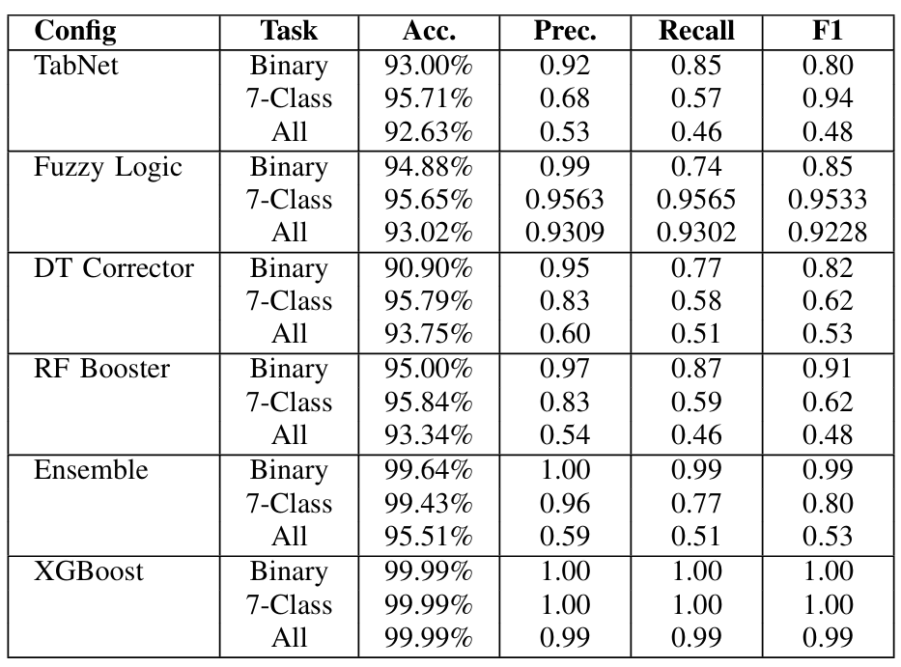
RESULTS AND ANALYSIS
The proposed FuzzTabIDS framework was evaluated on the CICIDS-2017 dataset using binary, 7-class, and all-class intrusion detection tasks. The TabNet baseline provided a solid starting point but showed limited recall for minority attack classes. Incorporating the fuzzy logic layer significantly improved precision and recall by adaptively handling uncertain predictions near decision boundaries. Further refinement through micro-correction modules using Decision Tree and Random Forest helped recover hard-to-classify and minority samples. The ensemble learning stage substantially enhanced robustness, achieving over 99% accuracy for binary and multi-class tasks. Finally, the XGBoost-based residual correction layer refined the remaining misclassifications, resulting in near-perfect performance with 99.99% accuracy across all evaluation settings. Validation using stratified cross-validation and temporal split confirmed the robustness and generalization capability of the proposed system.
Table: Results for FuzzTabsIDS over each stages
776
2025 IEEE International Conference on Recent Advances in Computing and Systems, 19 -20 Dec 2025 | ABV-IIITM Gwalior India

Slide 11
CONCLUSION & FUTURE SCOPE
Conclusion
FuzzTabIDS achieved outstanding accuracy and reliability by combining MRMR feature selection, TabNet, fuzzy logic, and ensemble corrections. It effectively improves detection precision, recall, and interpretability for modern IDS applications.
Future Scope
• Test on more datasets like NSL-KDD and BoT-IoT. • Optimize for real-time intrusion detection. • Add online learning for adaptive updates. • Enhance model explainability and visualization.
776
2025 IEEE International Conference on Recent Advances in Computing and Systems, 19 -20 Dec 2025 | ABV-IIITM Gwalior India

Slide 12
REFERENCES
M. A. Umar, Z. Chen, K. Shuaib, and Y. Liu, ”Effects of Feature Selection and Normalization on Network Intrusion Detection,” Data Science and Management, vol. 8, no. 1, pp. 23–39, 2025. doi: 10.1016/j.dsm.2024.08.001.
M. Aljanabi and M. A. Ismail, ”Improved Intrusion Detection Algorithm Based on TLBO and GA Algo rithms,” The International Arab Journal of Information Technology, vol. 18, no. 2, pp. 161–168, Mar. 2021. doi: 10.34028/iajit/18/2/5.
B. Hui and K. L. Chiew, ”An Improved Network Intru sion Detection Method Based on CNN-LSTM,” Journal of Advanced Research in Applied Sciences and Engi neering Technology, vol. 44, no.1, pp. 225–238, 2025. [Online].
V. Hnamte, H. Nhung-Nguyen, J. Hussain and Y. Hwa Kim, ”A Novel Two-Stage Deep Learning Model for Network Intrusion Detection: LSTM-AE,” in IEEE Ac cess, vol. 11, pp. 37131-37148, 2023, doi: 10.1109/AC CESS.2023.3266979.
O. Arreche, I. Bibers and M. Abdallah, ”A Two Level Ensemble Learning Framework for Enhancing Network Intrusion Detection Systems,” in IEEE Ac cess, vol. 12, pp. 83830-83857, 2024, doi: 10.1109/AC CESS.2024.3407029.
Babu, Kunda Suresh, Vallepu Srinivas, Yamani Chan dana, G. Satish, R. Dhandu Naik, and Dodda Venkata Reddy. ”Streamlined network intrusion detection: Feature selection optimization for higher accuracy and effi ciency.” In Advances in Electrical and Computer Tech nologies, pp. 114-124. CRC Press, 2025.
G. Tripathi, V. K. Singh, V. Sharma and M. V. Vinodb hai, ”Weighted Feature Selection for Machine Learning Based Accurate Intrusion Detection in Communication Networks,” in IEEE Access, vol. 12, pp. 20973-20982, 2024, doi: 10.1109/ACCESS.2024.3362794.
Rao, Y.N.; Suresh Babu, K. An Imbalanced Generative Adversarial Network-Based Approach for Network Intru sion Detection in an Imbalanced Dataset. Sensors 2023, 23, 550. https://doi.org/10.3390/s23010550
K. Peng, V. C. M. Leung, L. Zheng, S. Wang, C. Huang, and T. Lin, ”Intrusion Detection System Based on Decision Tree over Big Data in Fog Environment,” Wire less Communications and Mobile Computing, vol. 2018,
Article ID 4680867, 2018. doi: 10.1155/2018/4680867.
Dash, N., Chakravarty, S., Rath, A. K., Giri, N. C., AboRas, K. M., & Gowtham, N., “An optimized LSTM based deep learning model
for anomaly network intrusion detection,” Scientific Reports, vol. 14, no. 1, p. 4286, 2025,
doi: 10.1038/s41598-025-85248-z.
776
2025 IEEE International Conference on Recent Advances in Computing and Systems, 19 -20 Dec 2025 | ABV-IIITM Gwalior India

